Slide 1
FPGA - Project Installation
Installation of the previous year TIFR-FCRIT FPGA project

Slide 2
Steps Followed:
We followed the instructions in the cookbook provided to us for the installation of the project.
The Nexys3 and NexysA7 boards were connected to a laptop via micro-USB cables.
Next, the Nexys3 board pins JD 3 and 4 were connected to JA 2 and 3 pins on Nexys A7 board, respectively, via cables.
Next, the python code was run on the same laptop. This program shows us the output from UART on the terminal.

Slide 3
Steps followed: (Contd..)
Accordingly, the ext_count.bit file was burnt to the Nexys A7 board followed by the burning of pulse2.bit file to the Nexys3 board.
The pulse2.bit file sends the start and stop signals to the Nexys A7 board.
The output signal from Nexys3 acted as the input clock pulse to the NexysA7 board.
We recorded the output for two test cases.
50ns delay
100ns delay
The output can be viewed both on the NexysA7 FPGA and terminal where the python code was running.

Slide 4
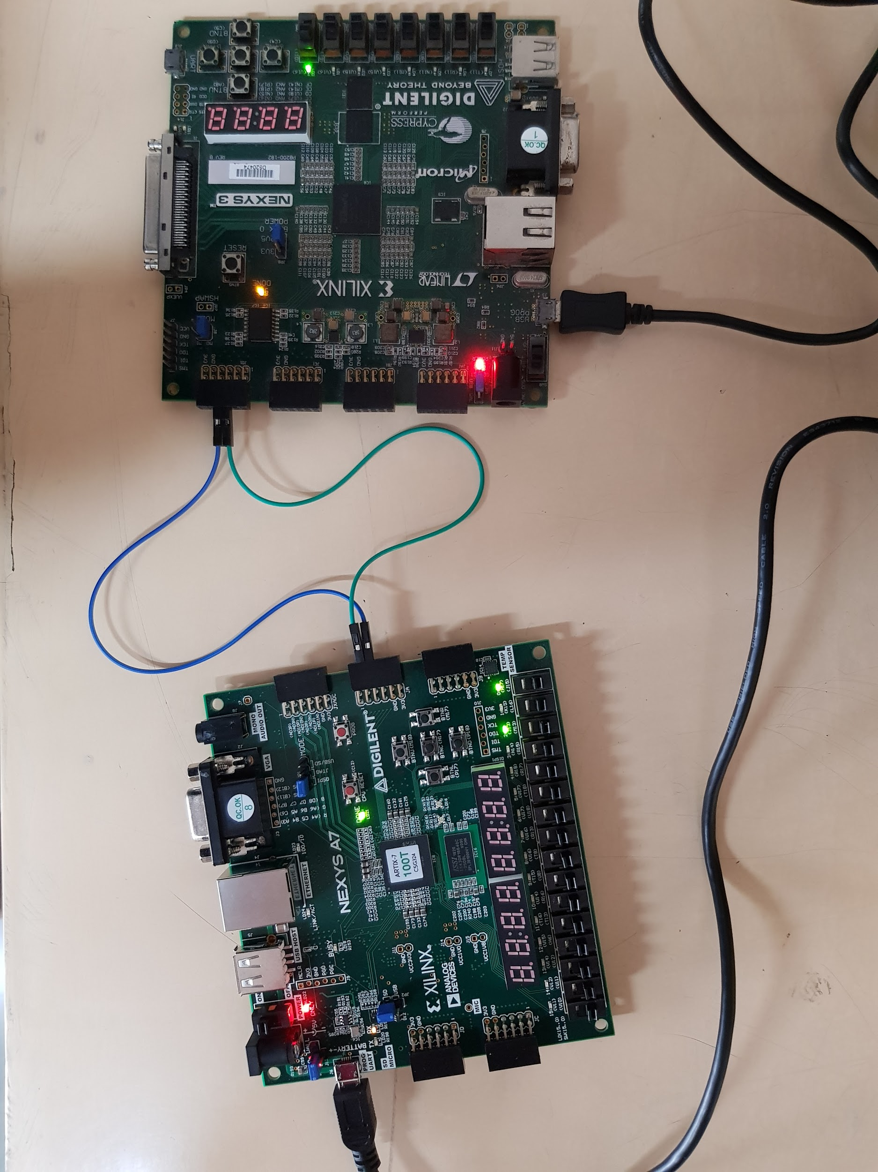
1) 50ns delay: The reference clock for the coarse counter is 10ns. Therefore, the output was 50/10=5.

Slide 5
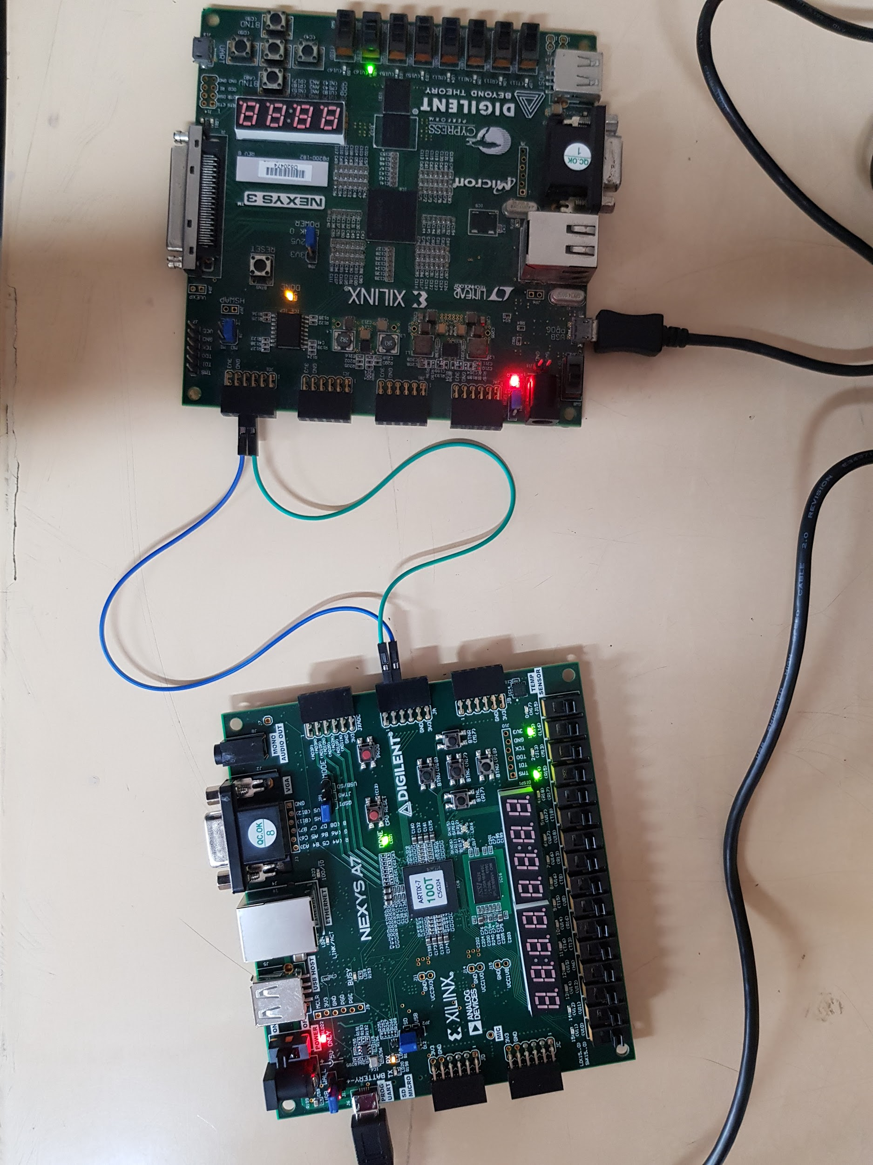
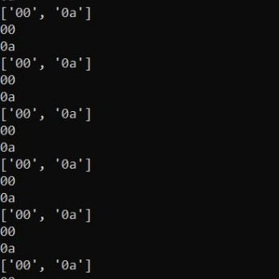
2) 100ns delay: The reference clock for the coarse counter is 10ns. Therefore, the output was 100/10=10.

